Slide 1
State Transition Testing
MADHESWARI.K
AP/CSE

Slide 2
State-based Testing
Also called as State Transition Testing
Based on the concepts of states and finite-state machines
allows the tester to view the developing of software in term of,
its states, transitions between states, and the inputs and events that trigger state changes.
The tester gets an additional opportunity to develop test cases to detect defects that may not be revealed using the input/output condition, as well as cause-and-effect views

Slide 3
State-based Testing contd…
A state is an internal configuration of a system or component. It is defined in terms of the values assumed at a particular time for the variables that characterize the system or component.
A finite-state machine is an abstract machine that can be represented by a state graph having a finite number of states and a finite number of transitions between states.

Slide 4
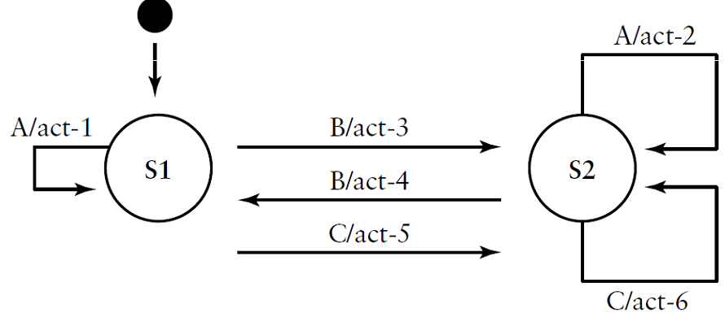
A simple State Transition Graph

Slide 5
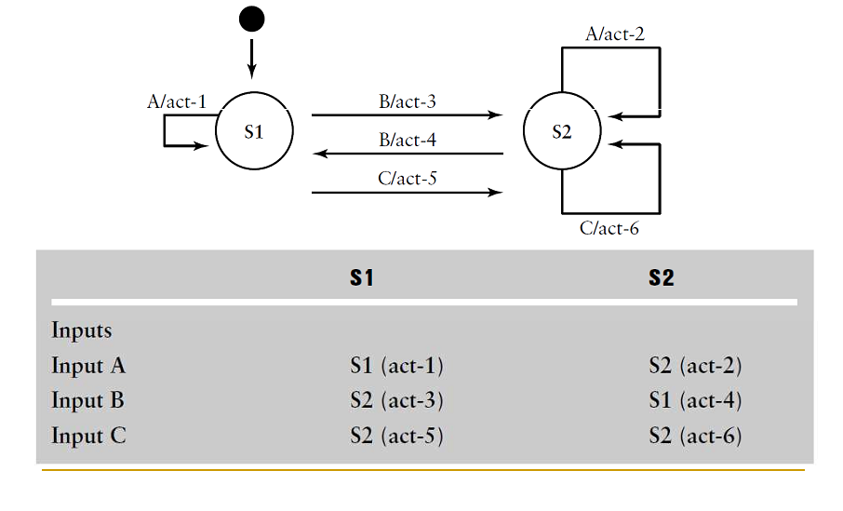
State Table

Slide 6
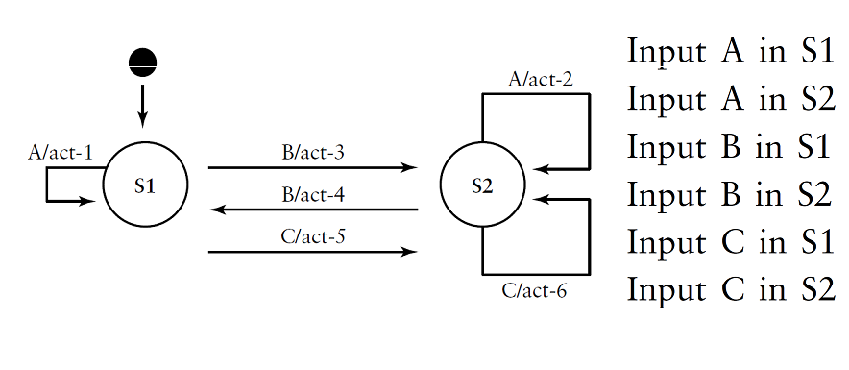
Transitions to be tested

Slide 7
State-based Testing contd…
A state is an internal configuration of a system or component. It is defined in terms of the values assumed at a particular time for the variables that characterize the system or component.
A finite-state machine is an abstract machine that can be represented by a state graph having a finite number of states and a finite number of transitions between states.

Slide 8
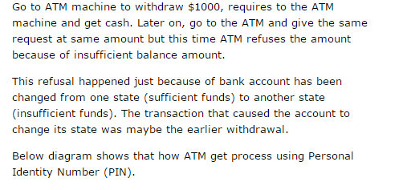
An example to explain State transition testing technique:

Slide 9
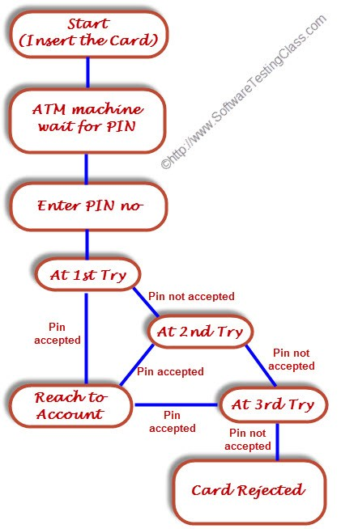
state diagram

Slide 10
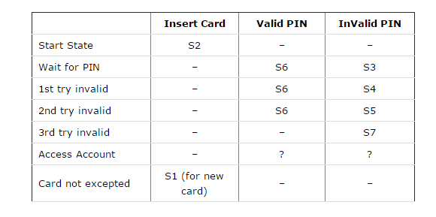
Test Case

